Slide 1

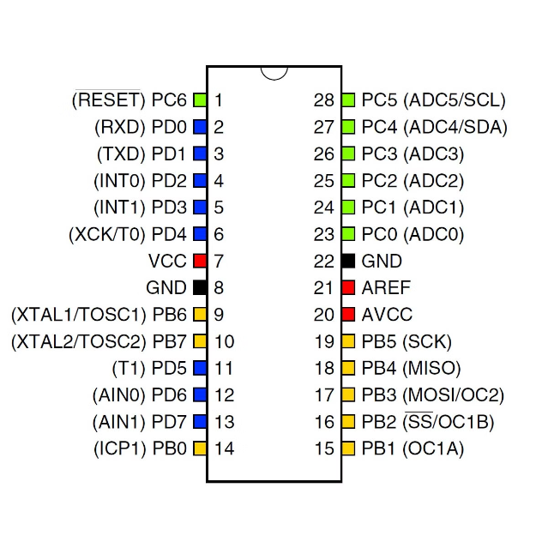


Introduction to 8-bit AVR Microcontrollers
AVR microcontrollers are a popular family of 8-bit processors used in a wide range of embedded systems and Arduino projects. These versatile chips offer a balance of performance, power efficiency, and ease of use, making them an excellent choice for hobbyists and professionals alike.
by Swaraj Kumar

Slide 2
Overview of the AVR Microcontroller Family
ATmega8
ATmega168/328
ATmega1280/2560
Entry-level AVR with 8KB flash, 1KB RAM, and 23 I/O pins.
The most widely used AVR chips, with up to 32KB flash and 2KB RAM.
High-end AVRs with up to 256KB flash and 8KB RAM, used in Arduino Mega.

Slide 3

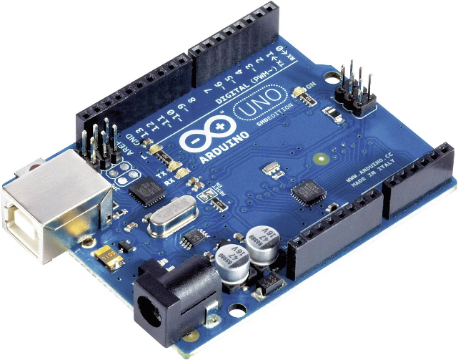
Arduino and AVR Microcontrollers
1
Arduino Platform
Arduino is an open-source electronics prototyping platform based on AVR microcontrollers.
2
Compatibility
Arduino boards like the Uno and Mega use AVR chips like the ATmega328 and ATmega2560.
3
Easy Programming
The Arduino IDE simplifies AVR programming, making it accessible to hobbyists and beginners.

Slide 4
Microcontroller Pinout and Peripherals
Pins and Ports
Peripheral Interfaces
Flexible Hardware
AVR chips have multiple I/O ports with digital and analog pins for interfacing.
AVRs support common protocols like UART, SPI, I2C, and PWM for connectivity.
The rich peripheral set allows AVRs to be used in a variety of embedded applications.

Slide 5


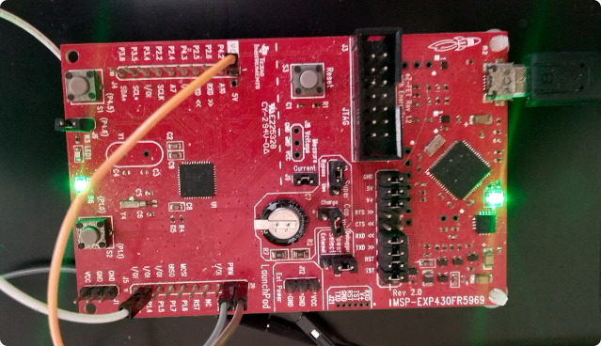

Analog and Digital Signal Processing
Analog-to-Digital
AVR ADCs convert analog signals to digital values for processing.
Pulse-Width Modulation
PWM outputs simulate analog voltages for driving motors, LEDs, and more.

Slide 6
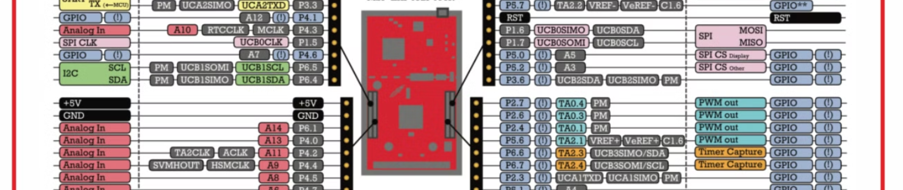
Digital I/O and Interrupts
Digital Pins
Interrupt Handling
Flexible Control
AVR I/O pins can be configured as digital inputs or outputs.
External and internal interrupts allow fast response to events.
Digital I/O and interrupts enable precise monitoring and control.

Slide 7

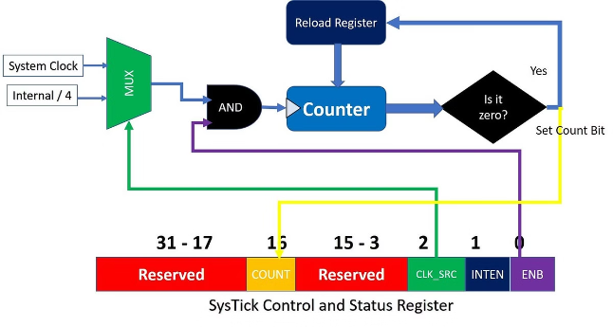
Timers and Real-Time Applications
1
Timer/Counter
AVR chips have multiple timer/counter modules for timing and PWM.
2
Clock Generation
Timers can generate accurate clock signals for real-time applications.
3
Scheduling
Interrupts triggered by timers enable event-driven and multi-tasking programs.

Slide 8
Serial Communication Protocols
UART
SPI
I2C
Serial port for asynchronous, full-duplex communication with PCs and peripherals.
Synchronous serial interface for fast, efficient, and reliable data transfer.
Two-wire serial bus for communicating with low-speed peripheral ICs.

Slide 9


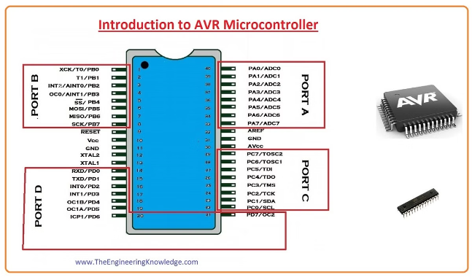


AVR Memory Architecture
Program Memory
Flash memory stores the compiled program code.
Data Memory
SRAM provides volatile storage for variables and data.
EEPROM
Non-volatile EEPROM retains data even when powered off.

Slide 10

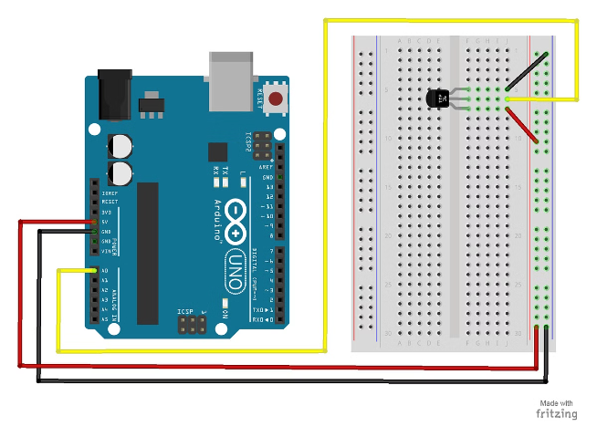
Why Use AVR Microcontrollers in Arduino?
1
Performance
AVRs offer a good balance of speed, power, and cost.
2
Versatility
The rich peripheral set enables a wide range of applications.
3
Ecosystem
The Arduino platform simplifies development and has a thriving community.
4
Accessibility
Arduino makes AVR microcontrollers accessible to hobbyists and beginners.

